Slide 1
Conaway Conference 2015
Brad Jones, P.E.
Deputy Director
Division of Construction Management

Slide 2

2014 Construction Season
ODOT Sold: 750 projects - $1.78 B
Emergency Projects:
          22 Type A - $ 5.9 M
          8 Type B - $ 7.0 M
          5 Type C - $1.5 M
Locals Sold: 273 projects - $347.8 M
Administered 4995 Subcontracts (C-92s)
Notes:
Last construction season, ODOT sold 750 construction projects totaling nearly $1.78 Billion.
On top of this you delivered another $14.4 Million of emergency work that was not planned.
In addition, our Local public partners sold 273 projects totaling $347.8 M. Many of the contractors in the room construction those project and the Federal Highway and ODOT staff are responsible for working with the locals and overseeing their administration of these projects.
4995 C92s (subcontracts) were approved and administered in association with this work.
All of this work combines for a grand total of $2.1Billion.

Slide 3
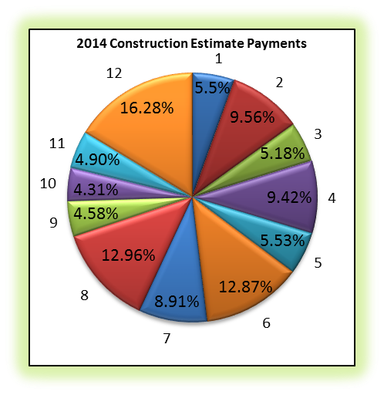
2014 Construction Estimate Payments
Notes:
All of this work pushed a lot of money into the economy…over $1.6B! In turn it created a lot of jobs.
You are all to be commended. A lot of effort and diligence goes into spending this amount money for transportation projects….lots of state and federal regulations!
You can see from the pie chart that each district contributed to this effort…meaning the dollars were spent all over the state.
Districts 12 expended the most at 16% which can be attributed to the Cleveland Innerbelt Bridges.
Districts 8 and 6 are close behind at 13%.

Slide 4
Dispute Resolution
Indicator of Success!
Year | Total # of Claims | # Heard by DCB | # Heard by ADR | # Dropped or Settled
2009 | 25 | 17 | 3 | 5
2010 | 18 | 13 | 0 | 5
2011 | 11 | 4 | 0 | 7
2012 | 12 | 7 | 0 | 5
2013 | 12 | 8 | 0 | 4
2014 | 13 | 1 | 0 | 7
Notes:
One indicator or success can be the number or volume of construction claims that we see.
You will hear more today about Partnering and our 3 Dispute Resolution Processes. All of those tools are working as is evidenced by these numbers.
Looking at this data you can see that we continue to see a low number of claims in relation to the volume of work. The data shown on this chart is specific to the number of Step 3 Claims that are escalated to the Director’s Claims Board.
As you can see, in 2014 there were 13 claims escalated to Step 3, 1 of those claims were Heard by the Board and 7 were resolved by the Districts and Contractors before being heard. This data is comparable to what we experienced the last two years…which is nearly half of the number of claims from just five years ago.
This clearly means that issues are being resolved at the project level, decisions are being made, and everyone is communicating and working solving problems. This is huge…you may not realize it but in many states they don’t even have a Dispute Resolution Process and they end up fighting many claims in the court systems.

Slide 5
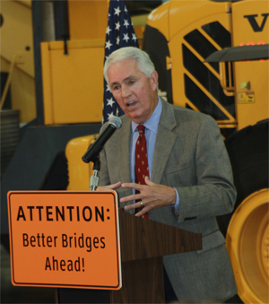
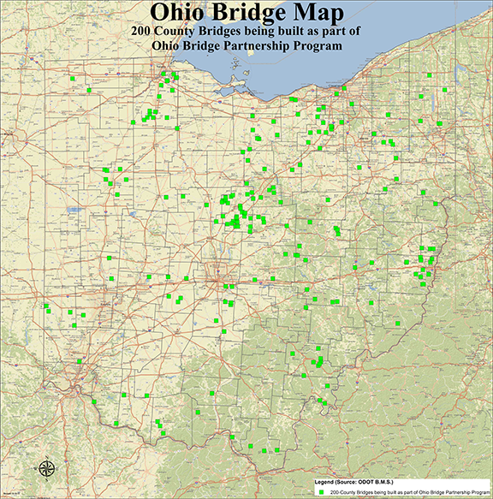
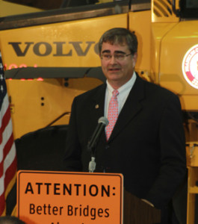
Ohio Bridge Partnership Program
SFY 2014: 30 Bridges - $12M
  28 Bridges Complete and Open
SFY 2015: 81 Bridges – 33 Packages - $42.7M
SFY 2016: 91 Bridges – 42 Packages - $45.3M
SFY 2017: 4 Bridges – 3 Packages - $2.6M
Notes:
Ohio Bridge Partnership
What a huge success, everyone involved is to be commended! A big thank you to CEAO, Ohio’s Municipalities, OCA, ACEC, MPOs, Contractors, Designers, and ODOT.
The Program had a total of 30 Bridges sell in SFY 2014 with an incredibly aggressive schedule and we were able to open all but two and those was due to utility issues. Construction is expected to begin soon.
For 2015, 23 Projects have been filed and 10 have been awarded.

Slide 6
2015 Construction Season
ODOT Sold: 152 Projects – $310.1 M
Still Scheduled: 555 Projects – $1.48 B
Emergency Projects: 3 Type C - $6.26 M
Local Projection: 242 Projects - $338.2 M
Notes:
Next, I am going to talk a little about this year’s construction season.
So far we have sold 152 projects for a total of $310M.
We have had a few Type C emergency projects.
Locals are projected to sell 242 projects for a total of $338M.
On track to sell over $1.80 Billion by ODOT

Slide 7
2014 Two-Step Design Build Projects
Project 13-3026; HAM – 71
Martin Luther King Interchange
$80.8M - Kokosing Construction Co.
Project 14-3005; SUM – 271
$44.5M - Great Lakes Construction
Project 14-3025; FAI – 22
$6.7M - Kokosing Construction Co.
Notes:
ODOT awarded three two-step Design Build projects in 2014.
A Request for Proposals was advertised and prospective bidders were shortlisted to three based on their Submittal of Qualifications. Teams were evaluated by Evaluation Teams made up of ODOT Central Office and District personnel.
The remaining three then submitted bids and the project was awarded to the lowest bidder.
1) Hamilton-71 Martin Luther King
2) Summit – 271
3) Fairfield – 22

Slide 8
2014 Value Engineering Change Proposals
% QTY Accepted: 53%
% Value Accepted: 54%
Notes:
In October 2011, ODOT opened the door to more VECPs by allowing more types of changes.
VECPs for MOT, Bridge Deck redesign, Sign supports, or VECPs which impact adjoining/future projects are now allowed.
Thus far, we haven’t seen many take advantage of this opportunity as much as we had anticipated but we are hopeful that we will see more innovation and cost savings in the future as a result of these changes.
Last year, we saw total savings of $3.3M as a result of VECPs that were pursued by contractors. These efforts are appreciated and we encourage you to continue working to find ways to save money and build high quality projects.

Slide 9
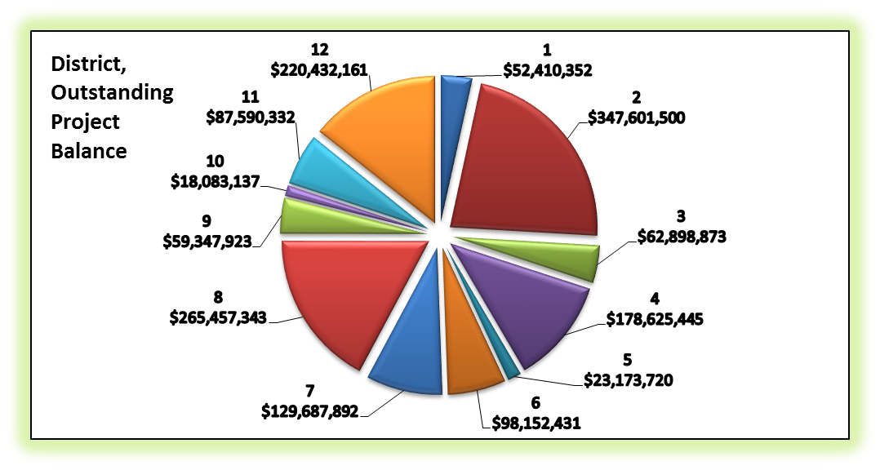
Capital Program Reporting
Currently over $3.4 Billion on active contracts
Currently over $1.5 Billion is remaining on payment
Notes:
These next few slides will show some information that ODOT senior leadership reviews and discusses every couple of months.
This pie chart is a summary of currently active projects. As you can see we have $3.4 Billion of work on Active contracts.
Of the currently active projects, 1.5 Billion is still to be paid. Many more projects will become active in the next couple months.
The pie chart shows the distribution of outstanding balances across the ODOT Districts.
It can be noted that Districts 2, 4, 8 and 12 have the majority of balance.

Slide 10
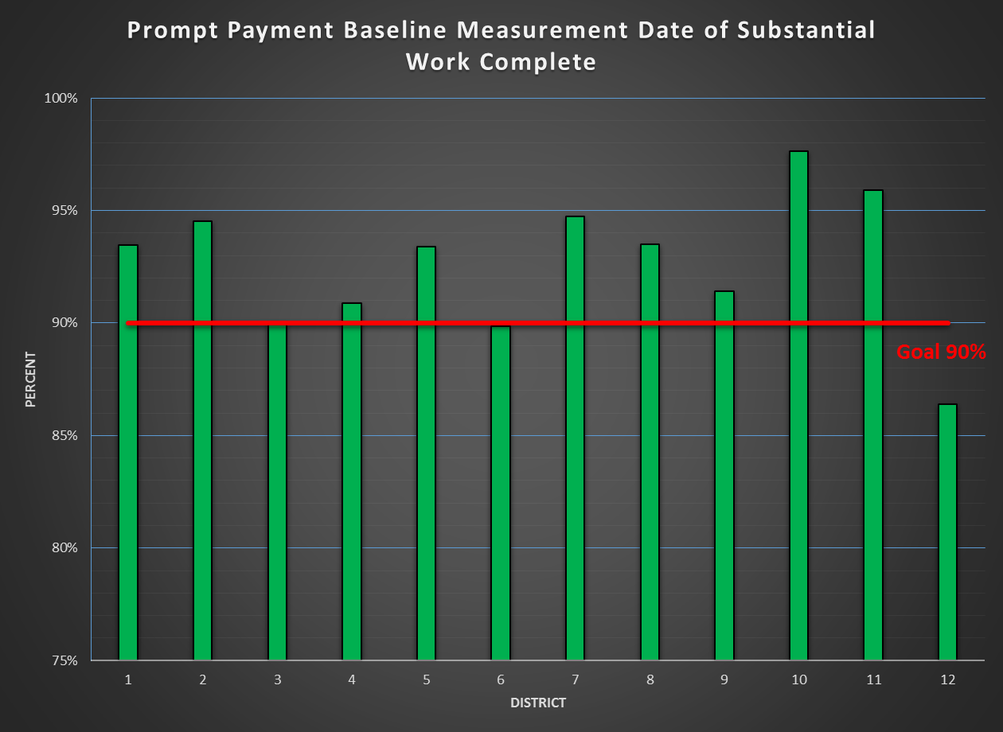
Prompt Payment Measurement
What is it:
A review of the payments on the original contract work after project acceptance.
Notes:
Components:
Projects that are completed and finalized.
A measure of dollars paid after the project has been accepted plus 15 days (estimate period).
Based on a rolling 365 day calendar.
Extra work and price adjustments are excluded from the measurement.

Slide 11





2014 Construction Awards
Flexible Pavements of Ohio: Quality Asphalt Paving Awards
ODOT Districts: 1, 3, 4, 5, 6, 9, 10(X2), 11
Contractors: KOKOSING (X3), SHELLY AND SANDS (X4) NORTHSTAR ASPHALT, Shelly
Notes:
Districts 1, 3, 4, 5, 6, 9, 10 (twice), and 11 all had projects that received “Quality Asphalt Paving Awards” from Flexible Pavements of Ohio.
The Contractors associated with these projects were Northstar Asphalt, Inc., The Shelly Company, The Kokosing Construction Company (x3), and Shelly and Sands (x4)

Slide 12





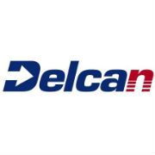
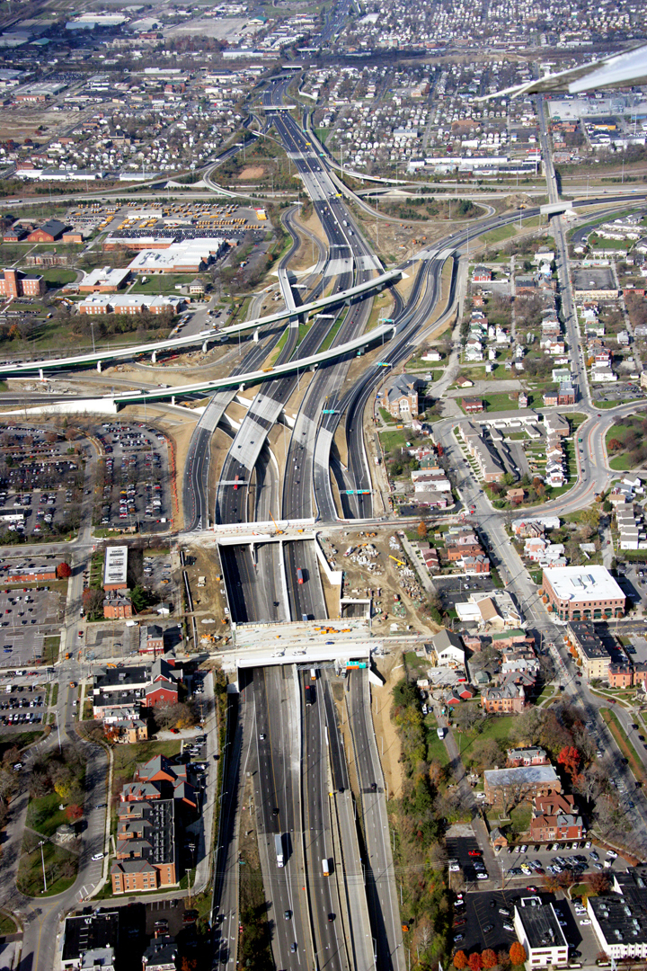
2014 Construction Awards
I-71/1-670 Interchange
Columbus Crossroads
Design Build Institute of America
National Award of Merit

Slide 13

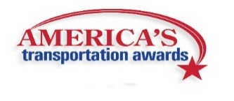
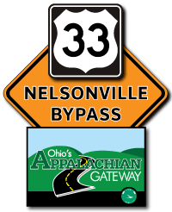
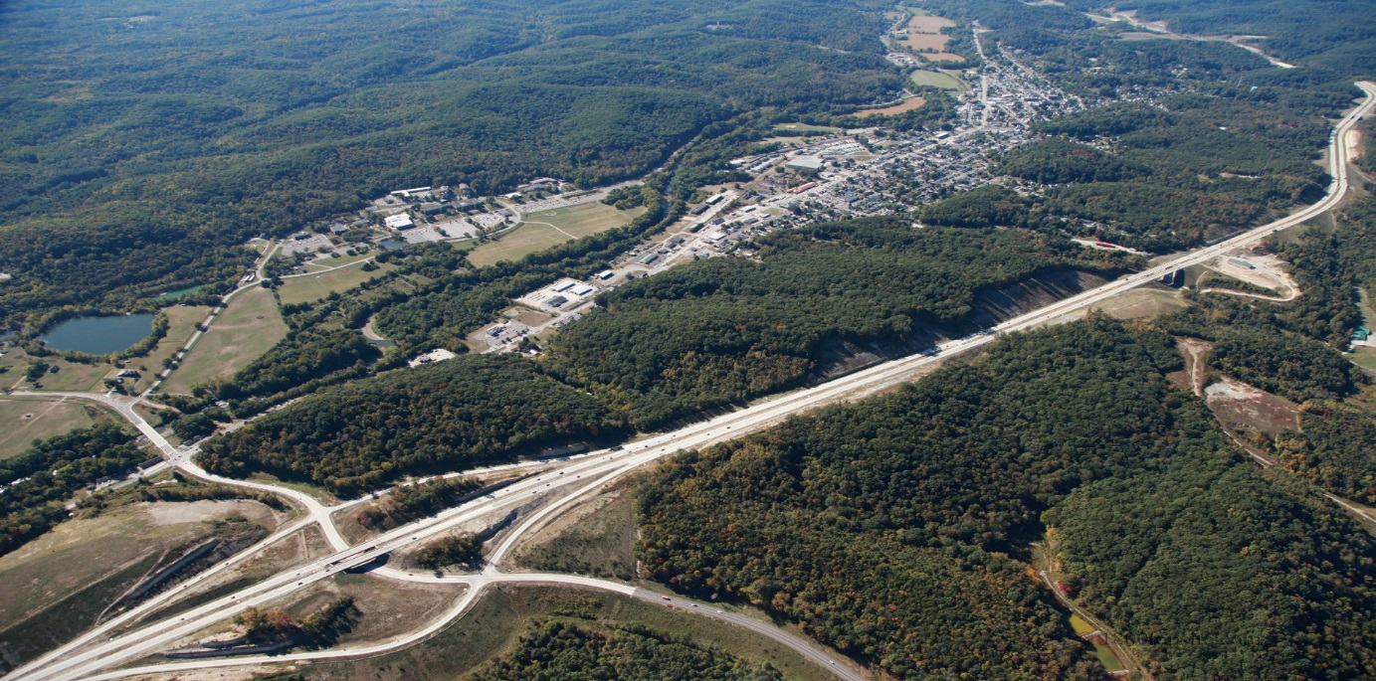
2014 Construction Awards
US 33 Nelsonville Bypass
AASHTO’s President’s Award for Environment
AASHTO’s Top 10 America’s Transportation Projects
Notes:
ODOT District 10’s Nelsonville Bypass Project won the Presidents Award for Environment sponsored by AASHTO. This is a national award that recognizes the best environmentally-friendly transportation project in America.
The Bypass Project was also selected as one of the AASHTO’s Top 10 America’s Transportation Projects. This is the first time an ODOT project ever made the Top 10.

Slide 14



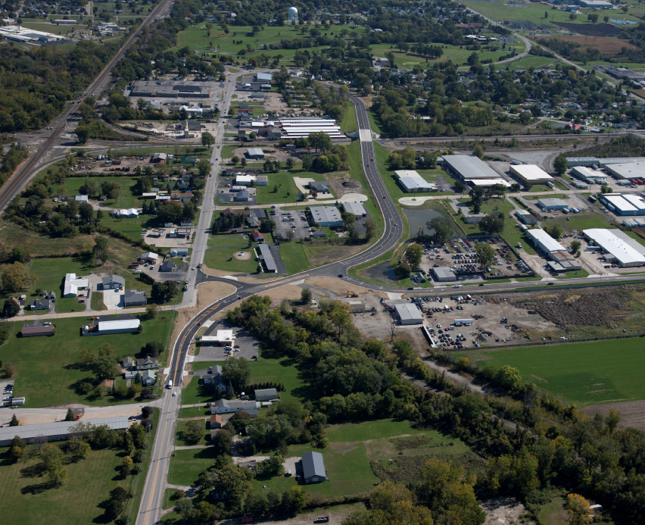
2014 Construction Awards
International Partnering Institute: Partnered Project of the Year
Ruby Level
ODOT District 3 and Mosser Construction
Project 11-0448, Rail/Highway Grade Separation
Notes:
ODOT District Three and Mosser Construction won an International Partnering Institute: Partnered Project of the Year Award. The team achieved “Ruby Level” status in the $25M - $250M Transportation Category.

Slide 15
Conaway Conference
Thank You

